Slide 1
Neurological Disorders Lesson 4.5
How do circuits regulate their output?

Slide 2
Do Now:
Review last night’s homework with a partner.
Be sure you can:
Describe the how the SCN connects to the flip-flop switch (sleep-wake circuit).
Describe how the activity of the SCN is regulated.
How does your body know what time it is?

Slide 3
How does the SCN connect?
Orexin neurons
VLPO
Arousal
neurons

Slide 4
How does the SCN connect when there is light?
Light
Orexin neurons
SCN
Pineal Gland
VLPO
Arousal
neurons
Notes:
Metabolic cues - glucose levels, leptin and ghrelin all affect activity of orexin neurons
Light/dark cycle - SCN encodes body’s clock influences activity of orexin neurons

Slide 5
How does the SCN connect in darkness?
Dark
Orexin neurons
SCN
Pineal Gland
Arousal
neurons
VLPO
Melatonin
Notes:
Metabolic cues - glucose levels, leptin and ghrelin all affect activity of orexin neurons
Light/dark cycle - SCN encodes body’s clock influences activity of orexin neurons

Slide 6
How is the activity of the SCN controlled?
What is this type of control called?
Feedback Inhibition
Behaviors & Activity
Clock Genes
Clock Proteins

Slide 7
Why do traffic lights have both green and red lights?

Slide 8
Student Model of Neuronal Control

Slide 9
Student Model 1
Input
What is this type of inhibition called?
Excitatory neuron (1)
Feedback inhibition
Inhibitory neuron (1)
Primary Neural Cell Body
Output
(ON/OFF)

Slide 10
Student Model 2
Input
Input
Excitatory neuron (2)
Excitatory neuron (1)
Inhibitory neuron (2)
Inhibitory neuron (1)
Primary Neural Cell Body
What is this type of inhibition called?
Feed-forward inhibition
Output
(ON/OFF)

Slide 11
Neuronal Control
Input
Input
Excitatory neuron
Excitatory neuron
Feedback inhibition
Inhibitory neuron
Inhibitory neuron
Primary Neural Cell Body
Feed-forward inhibition
Output
(ON/OFF)

Slide 12
Neurons in which feedback and feed-forward control is important

Slide 13
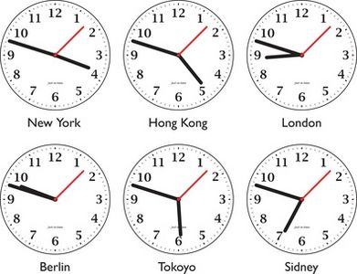
Why do we need feedback and feed-forward control?
Jet Lag
Seasonal Affective
Disorder
Monday Morning
Blues

